Slide 1
BYCTWD
Workshops | April 2018
Team Scratch
Carmine Valentino | Gio DeGrande

Slide 2
Workshop Agenda
How Apps Work and We Interact With Them
Hands On Programming With Scratch
A Fun Demo!

Slide 3
How We Interact with Apps
What is an Input?
What is an Output?

Slide 4
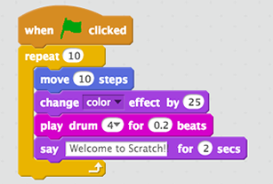
Scratch
Scratch is a project of the Lifelong Kindergarten Group at the MIT Media Lab - it is provided free of charge.
With Scratch, you can program your own interactive stories, games, and animations — and share your creations with others in the online community
Scratch helps young people learn to think creatively, reason systematically, and work collaboratively — essential skills for life in the 21st century

